Slide 1
Django web framework software metrics measurement using radon and Pylint

Slide 2
Python frameworks
Django
CherryPy
Pylons
Flask
Bottle
Pyramid
Tornado

Slide 3
Django ?
Django framework is a compact Python framework
Develop Web application
Fast and Quick development
Follows MVC architecture
Admin interface
Django forms
Templates
Views
Models

Slide 4
Radon
Cyclomatic Complexity
Maintainability Index
Halstead metrics
(Lines of Code )

Slide 5
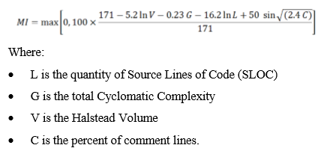
Formula for Maintainability Index :

Slide 6
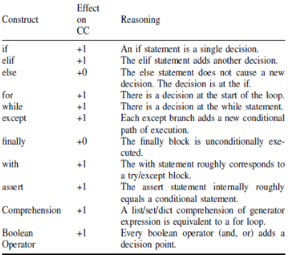
Cyclomatic Complexity Count

Slide 7
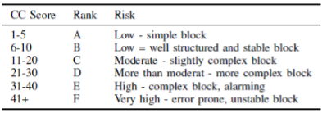
Cyclomatic Complexity Rank

Slide 8
Pylint
Pylint is a source code analyzer that finds for errors in programming, assists to use a coding standard strictly.
PyLint Score

Slide 9
Anandboreda.pythonanywhere.com

Slide 10
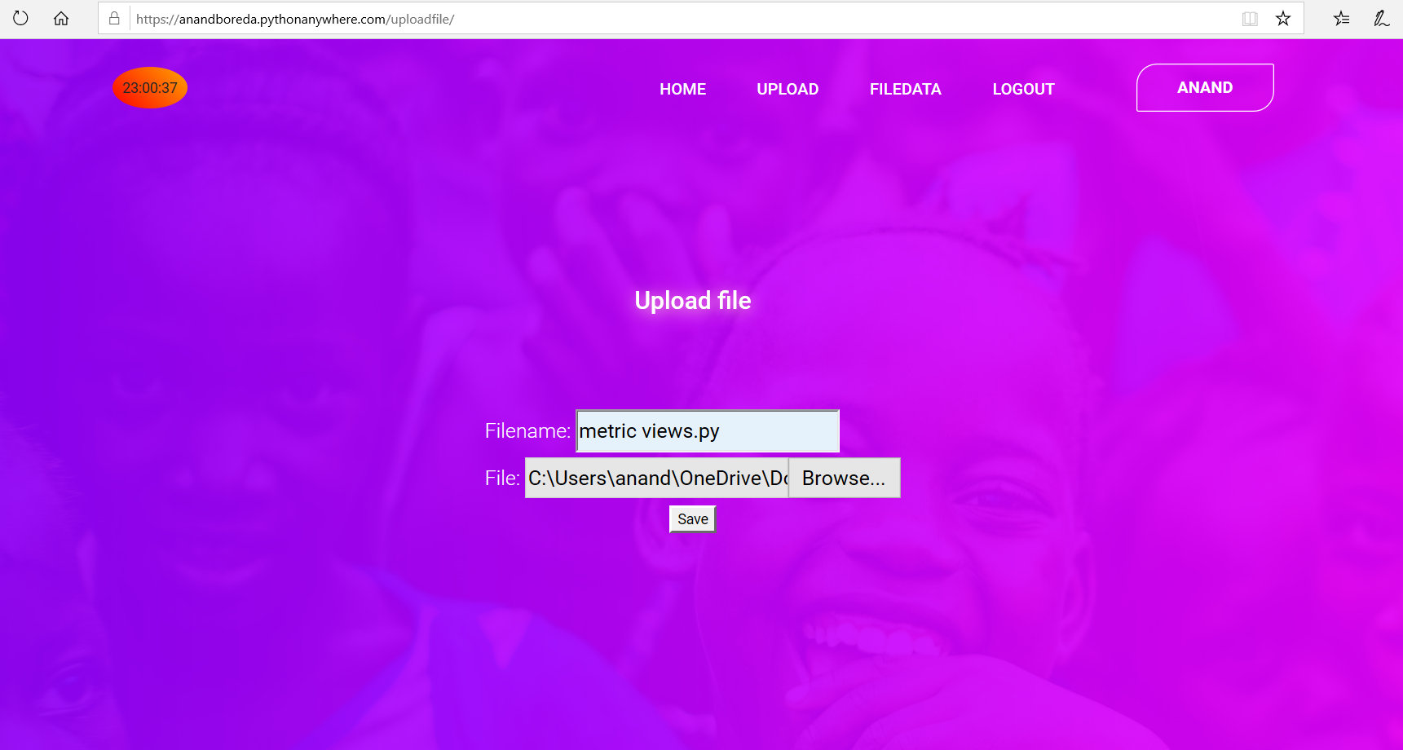
Upload python file

Slide 11
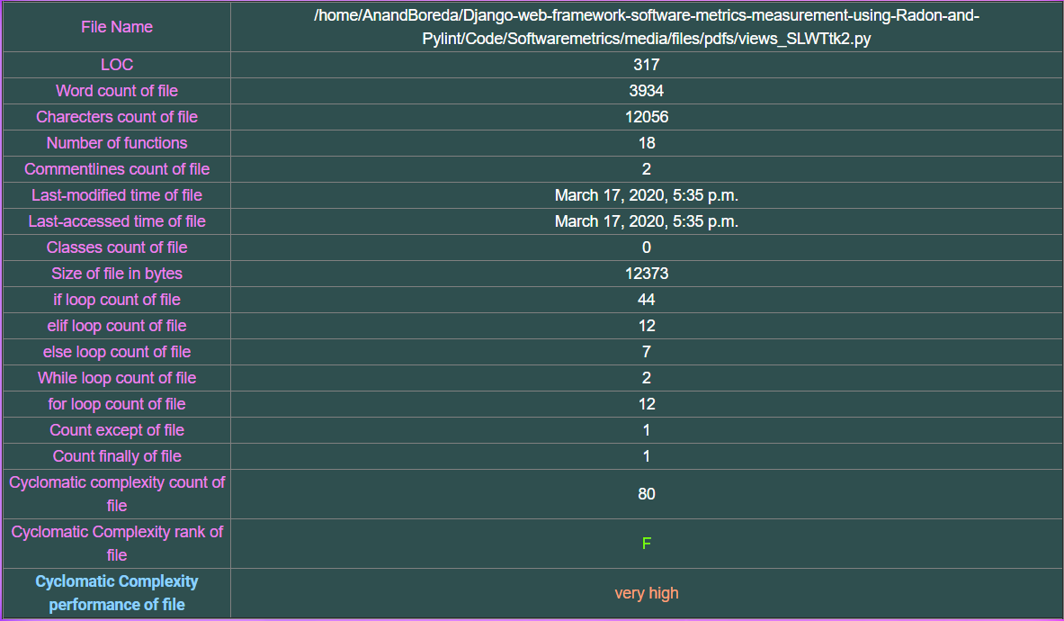
Metrics

Slide 12
Thank you

